Slide 1
Updates 2-2-21
Initial RRAM Characteristics
Stanford University
2/2/21

Slide 2
Status
Done with FORM, SET, RESET, Target Resistance
Done with checkerboard tests
Done with bitstream programming
Speed optimizations
Some yield optimizations
TODO:
Full Array FORM
Full Array program
Full Array yield analysis

Slide 3
Operation conditions
Operation | READ | FORM | SET | RESET
BL/SL Start (V) | 0.2 (BL) | 2 | 2 | 1.8
BL/SL Stop (V) | N/A | 4 | 2 | 1.8
BL/SL Step (V) | N/A | 0.5 | N/A | N/A
WL Start (V) | 2.5 | 0.9 | 0.9 | 0.9
WL Stop (V) | N/A | 1.5 | 1.5 | 1.5
WL Step (V) | N/A | 0.05 | 0.1 | 0.1
WL Pulse Width (us) | 2ms | 100 | 1 | 10
Stop Condition | N/A | < 50kΩ | Below target (10-11kΩ) | Above target (>70kΩ)
Loop Order | N/A | WL outer/ BL inner | WL only | WL only
Total FORM Time:
0.05s/cell
=
1 hr/array
Total Prog Time: 0.4s/cell
=
7 hrs/array

Slide 4
Notes on READ
Using 560Ω shunt resistor and reading voltage across it
Collecting 100 samples
2ms for BL voltage to ramp up to 200mV, then read current at 1MHz
Includes the transistor voltage drop

Slide 5
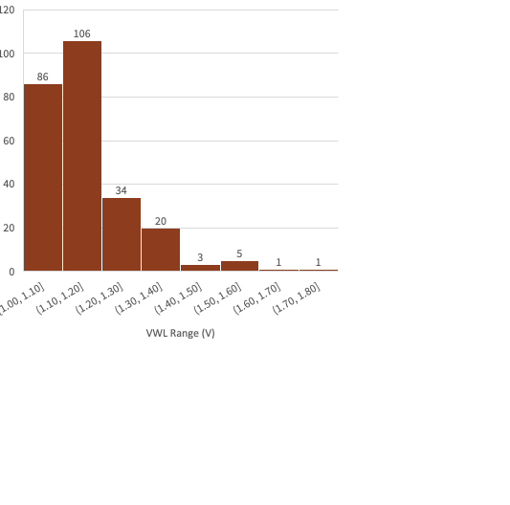
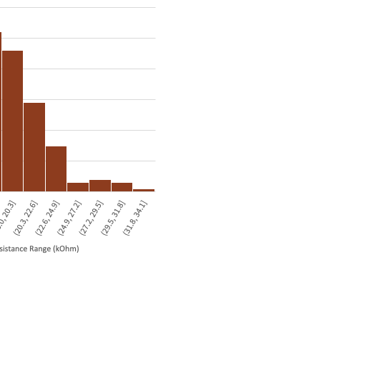
FORMing Distributions

Slide 6
Yield Problem: Over-FORM/Over-SET Problem
Resistance below 10kΩ is near impossible to RESET
Need to do FORMing carefully to ensure that RESET is possible
Pick correct voltages and step slowly

Slide 7
16x16 checkerboard test pattern
Error with single cell FORMed at VWL=1.7V
Cell cannot be fully RESET, only up to 20kOhm

Slide 8
16x16 anti-checkerboard test pattern
3 errors when trying to flip
Cells cannot be fully RESET, only up to 20-40 kOhm

Slide 9
Any more requests for data to be collected?
I-V sweep
Resistance tunability
VWL/VBL/VSL tuning curves
Retention
Endurance

